Slide 1

Analysis on Billionaires
By: Ryan McGuiness

Slide 2
Introduction
Materialism plays a prominent role in society
The billionaires data set contains information about billionaires around the world and how they acquired their wealth.
Using this data set, what actions could you take to become wealthier?

Slide 3
Abstraction
Abstraction is the process of turning real-world entities and phenomena into data. In this project, I abstracted Billionaires into a list of reports. Each of these reports has a number of properties that further develop my project.
“Age”- An integer that represents the current age of the billionaire. Ages that are represented as “-1” stand for ages that were not available in the data that was collected.
“Gender”- A string representing their gender.
“Year”- A integer that represents the year that the billionaire earned/ acquired their wealth.
“Worth in billions”- A float that stands for the number of billion of dollars that this billionaire is worth.

Slide 4
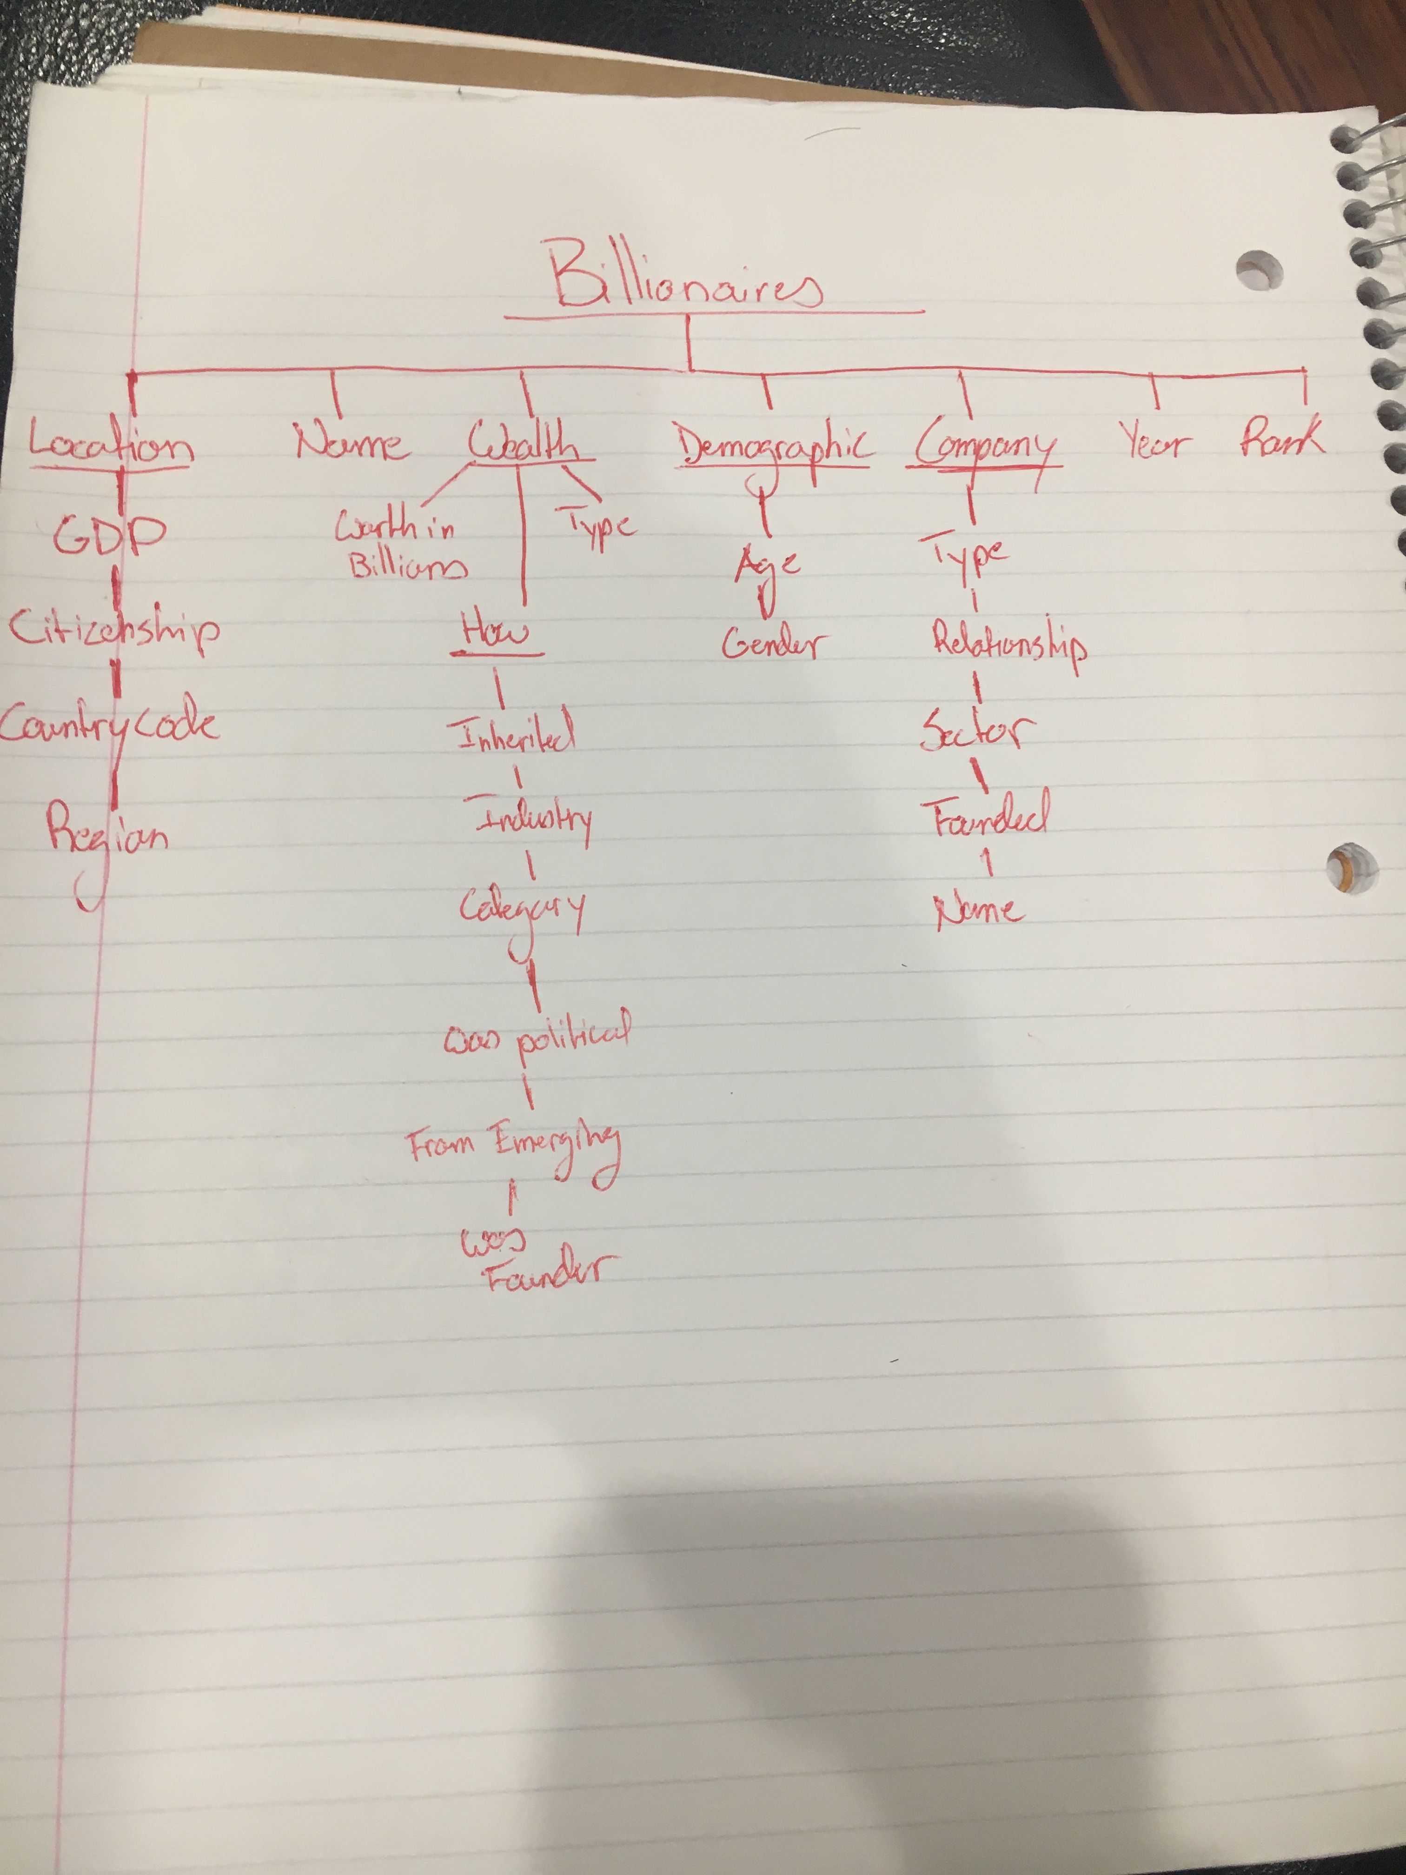
Structure
The diagram(right) shows the structure of the dataset that I abstracted.
The “age” key and “gender” key is in the dictionary associated with the “Demographic” key
The “worth in billions” key (Float) is associated under the “wealth” key in the dictionary.
They “year” key represents itself in the dictionary.

Slide 5
Limitations
The data set only contains information on current billionaires, therefore the information only represents only the most recent billionaire data.
For age and year the information has default setting, because the specific data could not be collected. Some of the data is skewed because of this.

Slide 6
Question 1
What is the difference in the amount of male billionaires compared to female billionaires?

Slide 7
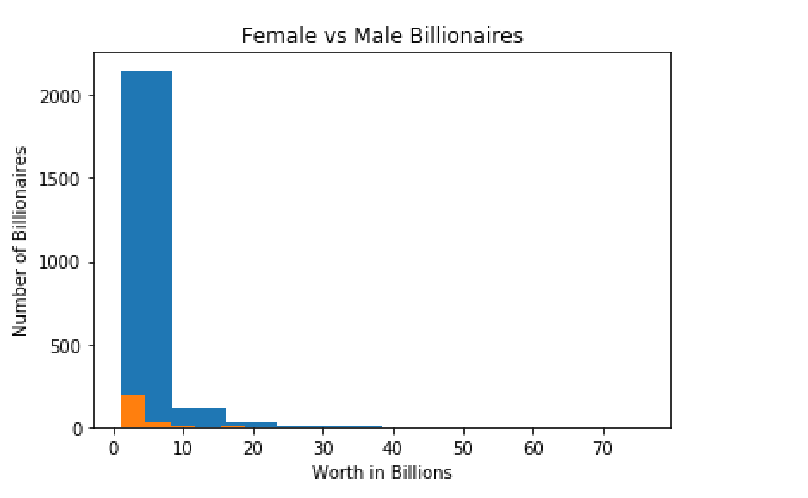
Visualization/Answer #1
There is a very obvious difference in the quantity of female billionaires(orange) compared to the amount of male billionaires(blue). Besides the difference in quantity the two graphs follow the same trend. The trend is that there are less and less billionaires as you look at their worth.

Slide 8
Question 2
Is there a trend between age and worth?

Slide 9
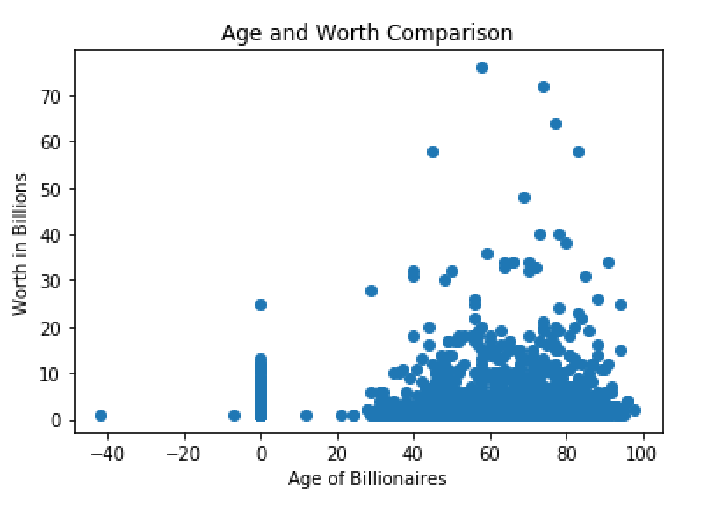
Visualization/ Answer #2
Each dot on the scatter plot represents a billionaire. The most concentrated area of this graph is between 30 and 90 years old. There are very few billionaires that are less than the age of 20. Although the graph is spread out, I would conclude that the more likely you are to be wealthier.

Slide 10
Question 3
When did most billionaires earn their wealth?

Slide 11
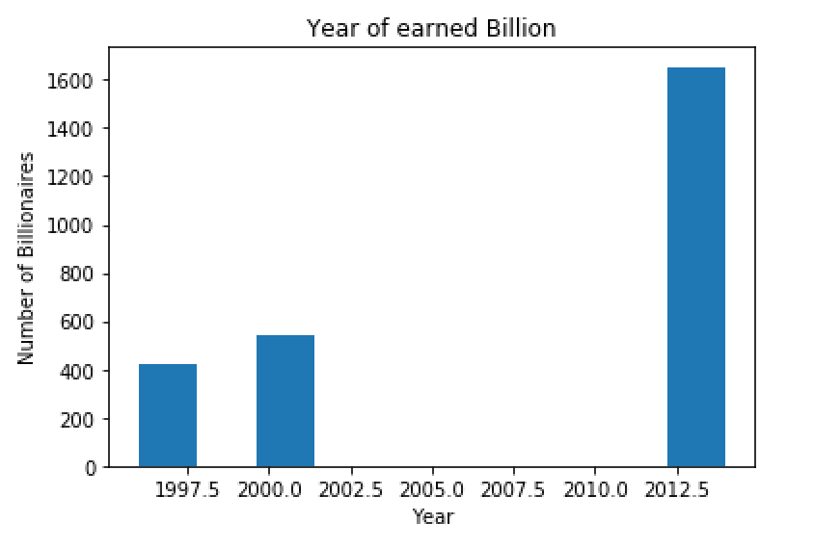
Visualization/Answer #3
From this graph of when billionaires made their money it seems that some of them made it early 2000’s and everyone else earned their money after 2010. I would say that the information that this graph is telling us is that there are more and more billionaires coming into this world.

Slide 12
Social Impacts
The stakeholder that would want to use this information could be :
Gender Equality Activist- it is very prominent that most billionaires are male, and with this information these activists can further develop their argument for equal rights
Marketers- People in marketing are always looking for ways to get money from other people’s pockets into theirs. With this information they could target billionaires because now they better understand the age range, gender, and locations.
Government- it is very important for the government to know and maintain good relations with the wealthy to keep an eye on their monetary expenses and if it is from affiliations in illegal activities.

Slide 13
Thank you
I, Ryan McGuiness, have neither given nor received unauthorized assistance on this assignment.

